Slide 1
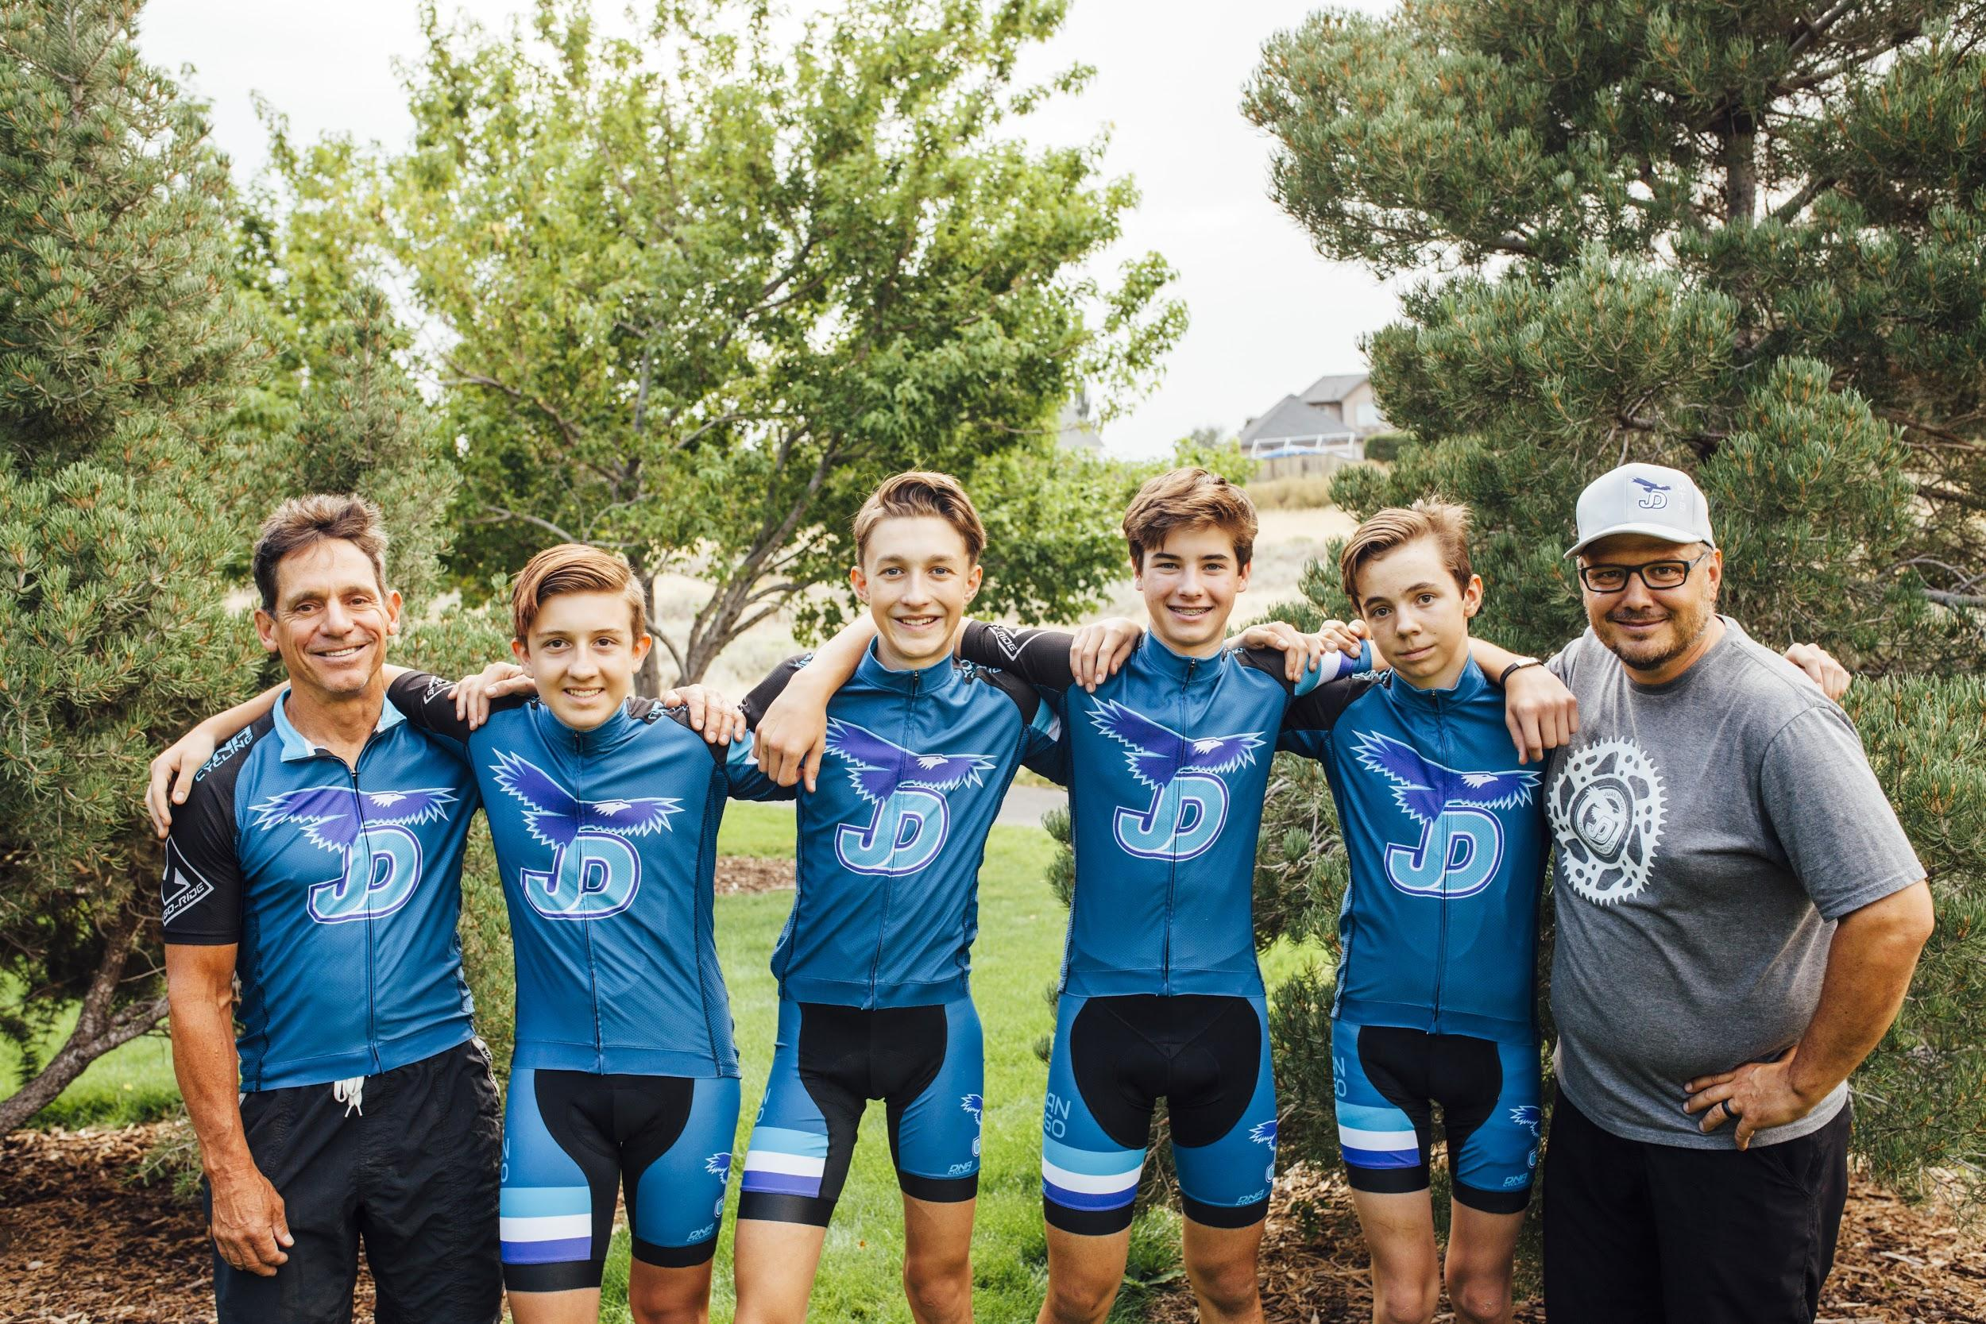


Team Meeting

Slide 2
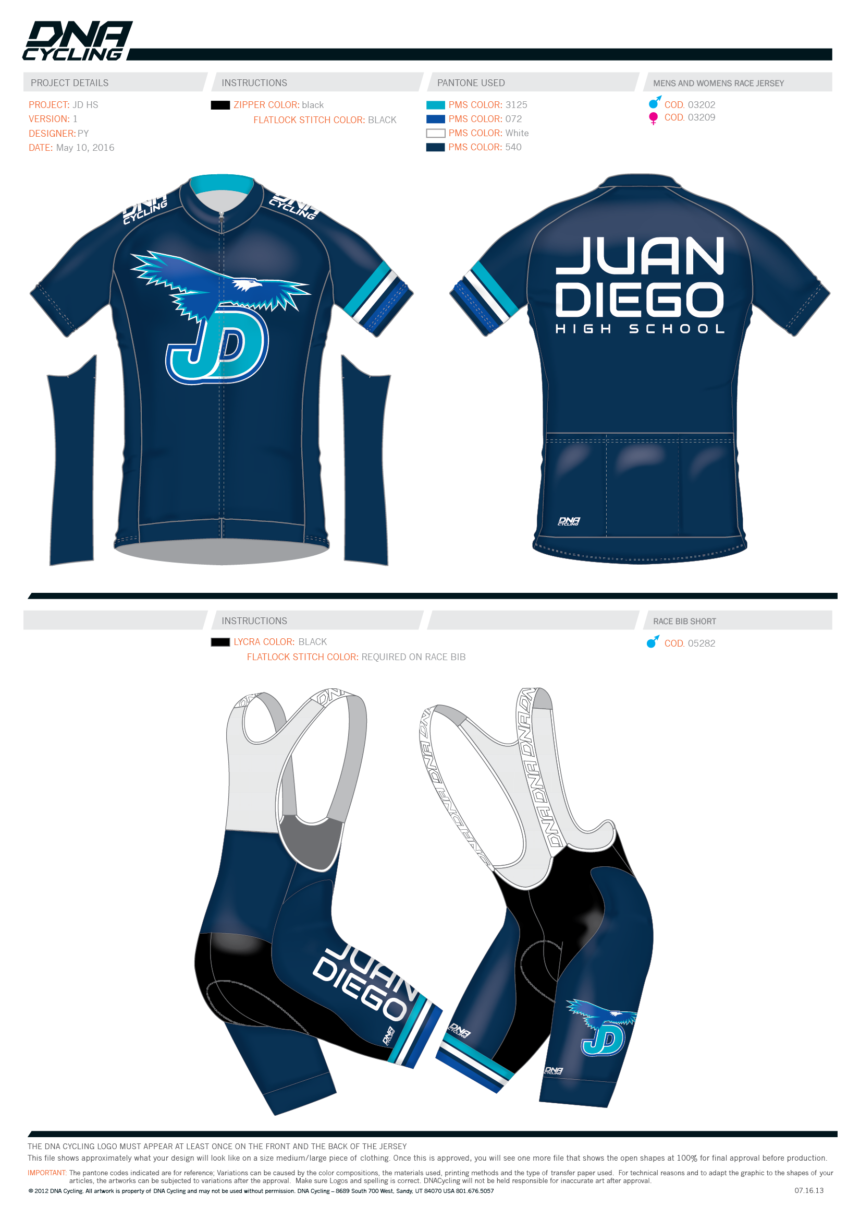
Overview
Introduction to Utah High School Mountain Biking
  History
  Vision
  Impact
Our Team
  What to Expect
  2018 Season Schedule
  We Need Your Support
Team Meeting

Slide 3


History

Slide 4

History
WE ARE PART OF THE
NATIONAL INTERSCHOLASTIC CYCLING ASSOCIATION
NICA is a 501(c)3 Non-Proﬁt Organization founded in 2009
NICA facilitates the development of youth cycling for grades 7th-12th nationwide by providing the licensing, training, and insurance to our coaches, teams, and volunteers.
Team Meeting

Slide 5
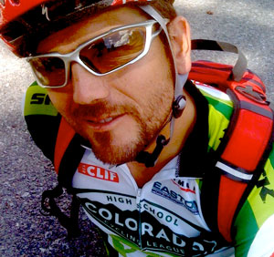
History
1998
Matt Fritzinger, a math teacher at Berkeley High School at the time, started a mountain
biking club with just 4 student-athletes.
2009
NICA was formed to take High School Mountain Biking coast to coast by 2020.
2011
Four leagues (NorCal, SoCal, Colorado and Washington) were racing with over 1,000 Student
athletes and 109 High School Teams. Utah submits bid to NICA and is announced a Project League
on Sept. 13, 2011
2012
Seven NICA leagues racing with 2,000 student-athletes competing. Utah makes history in becoming the largest first-year league with 328 registered student athletes and 230-240 racers.
2015
Pennsylvania, Arkansas, New Jersey and North Carolina become Leagues. Utah continues to be the largest league in size with over 60 teams and 1200 student athletes.
2016
Nineteen leagues formed. Utah splits into two regions with 2400 student athletes including 7th and 8th grade.
2018
Twenty two leagues formed. Utah splits into three regions with 3400 student athletes including 7th and 8th grade.
.
NICA Founder, Matt Fritzinger
Team Meeting

Slide 6
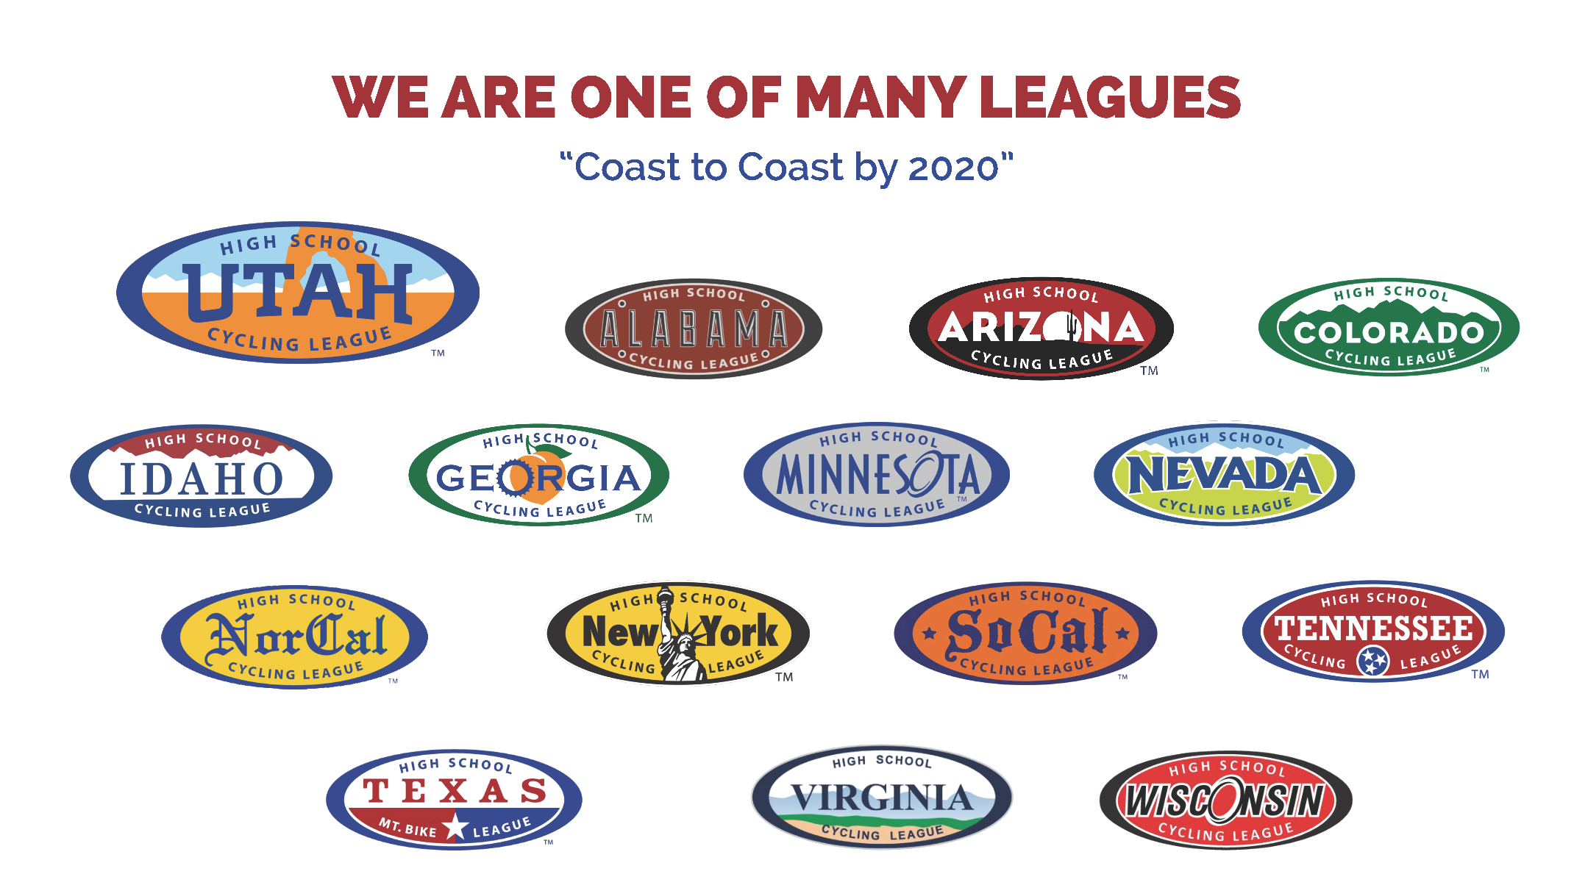







History
.
Team Meeting

Slide 7

History
.
Team Meeting

Slide 8
Vision
TO ENABLE EVERY UTAH TEEN TO STRENGTHEN BODY, MIND, AND CHARACTER THROUGH THE LIFELONG SPORT OF CYCLING
Here’s how…
Team Meeting

Slide 9
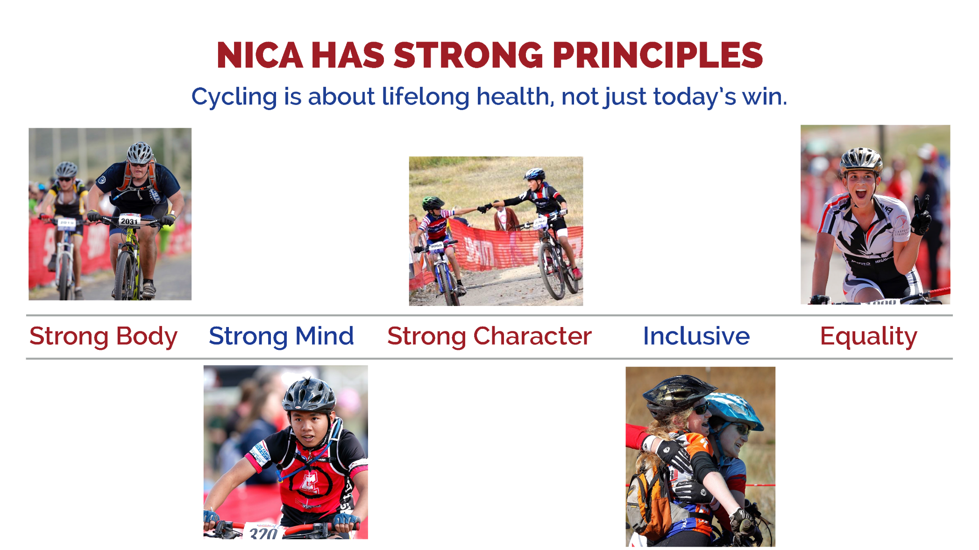
Vision
.
Team Meeting

Slide 10
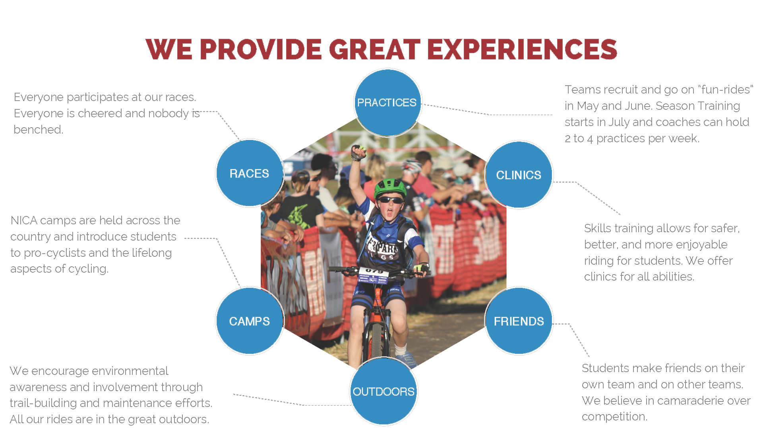
Vision
.
Team Meeting

Slide 11

Impact
.
Team Meeting

Slide 12
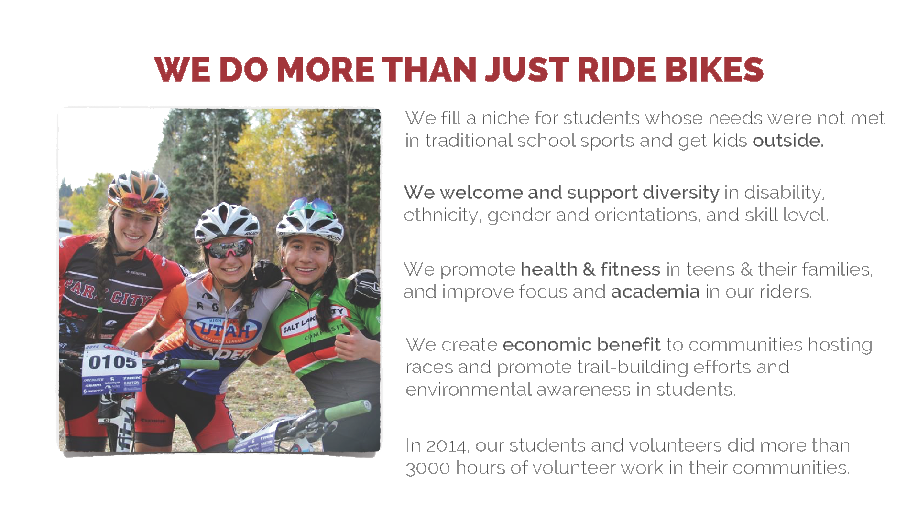
Impact
.
Team Meeting

Slide 13
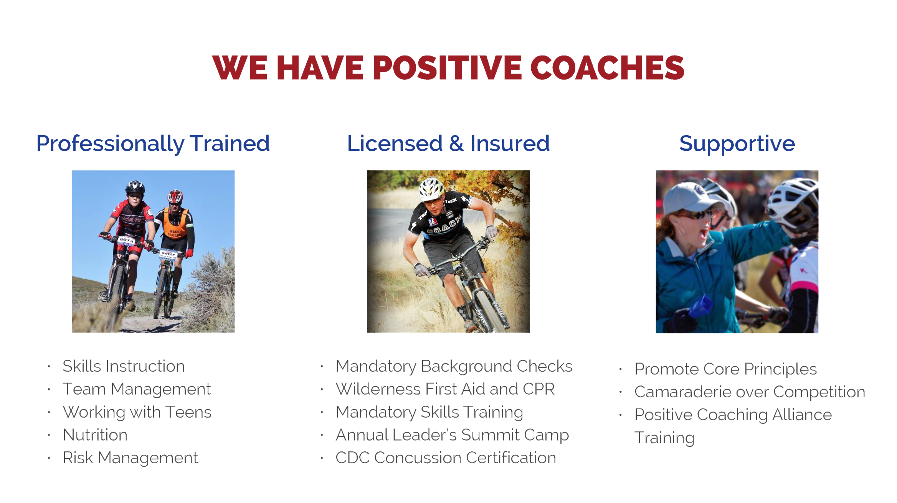
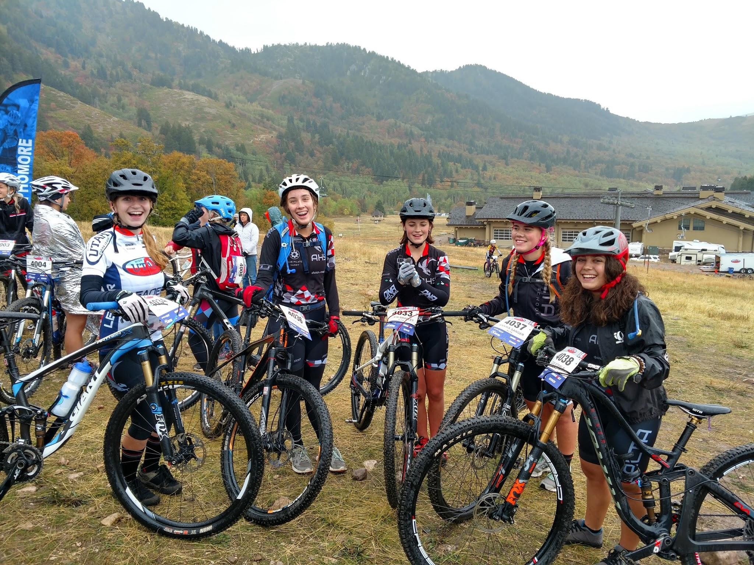
Impact
.
Team Meeting

Slide 14
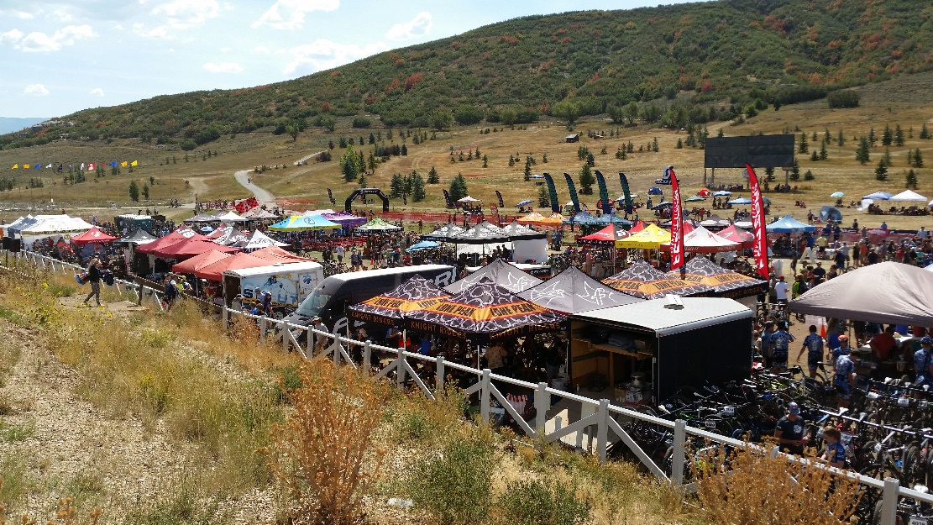
Impact
100 Teams And Growing
North Region
26 High School teams
21 Junior Devo teams
Central Region
18 High School teams
15 Junior Devo teams
South Region
26 High School teams
17 Junior Devo teams
Team Meeting

Slide 15
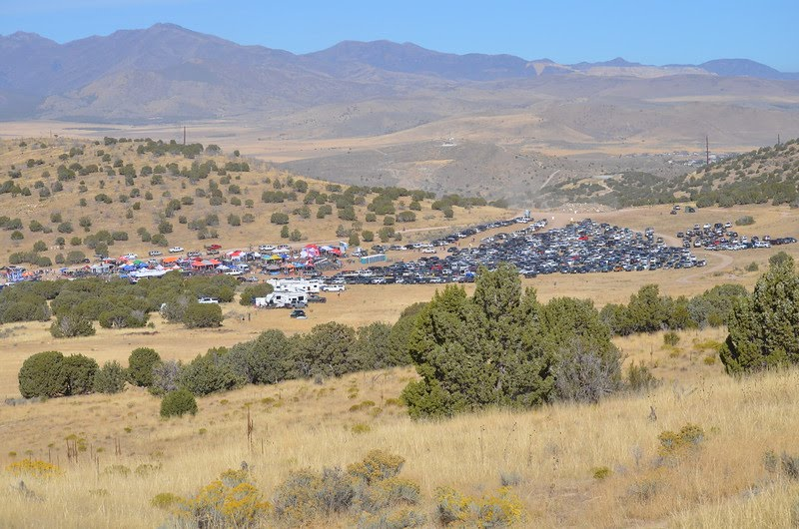
Impact
Central Region Teams
Alta
American Prep Academy
Bingham
Brighton
Copper Hills
Corner Canyon
Cottonwood-Hillcrest Comp
Herriman
Jordan
Juan Diego
Murray/Taylorsville Comp
Olympus
Riverton
South Summit
Uintah
Wasatch
West Granite Comp
Westlake
Team Meeting

Slide 16
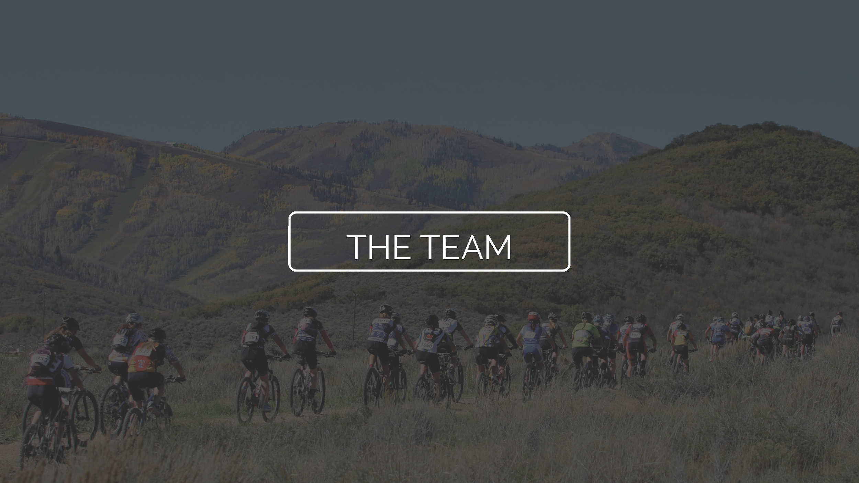
Vision
.
Team Meeting

Slide 17
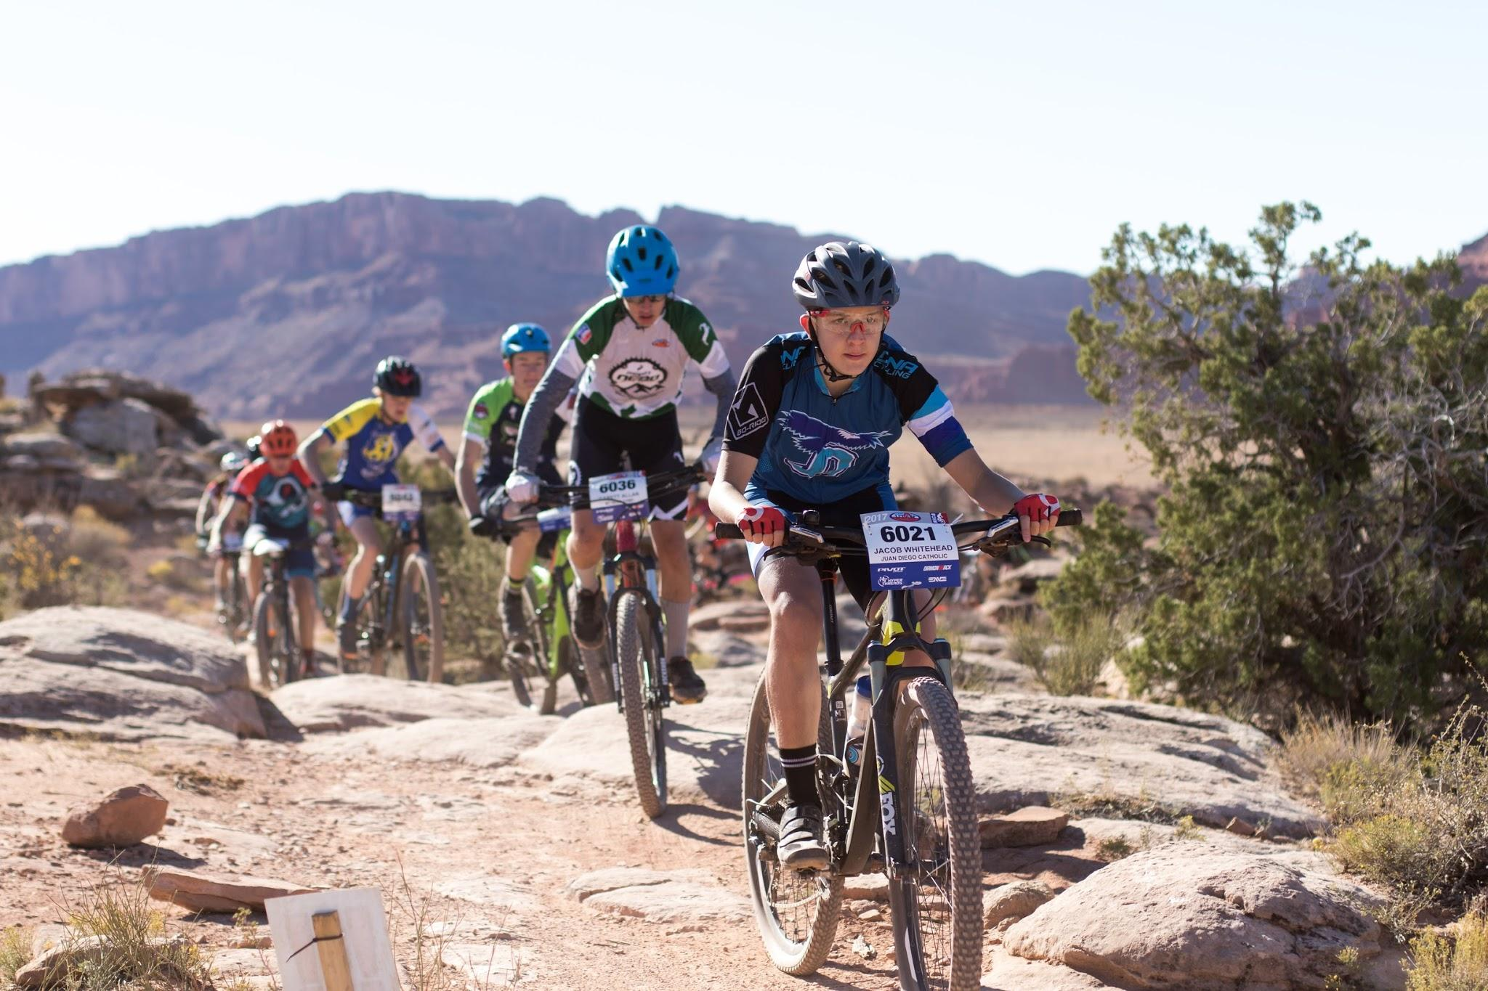
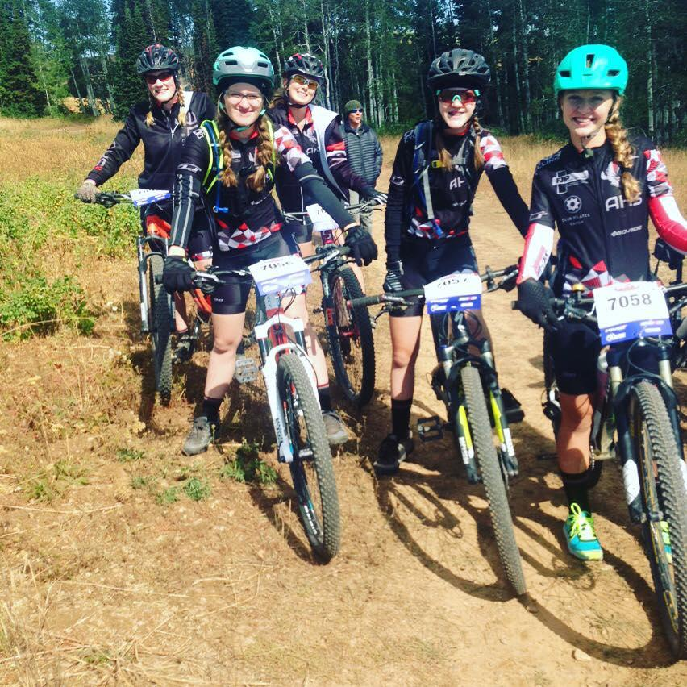
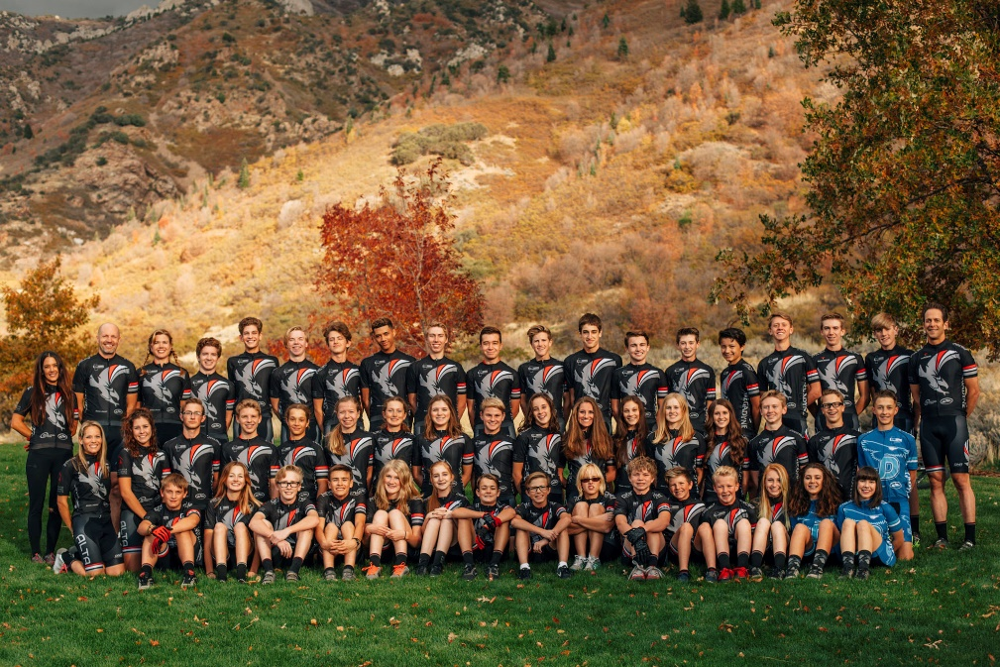
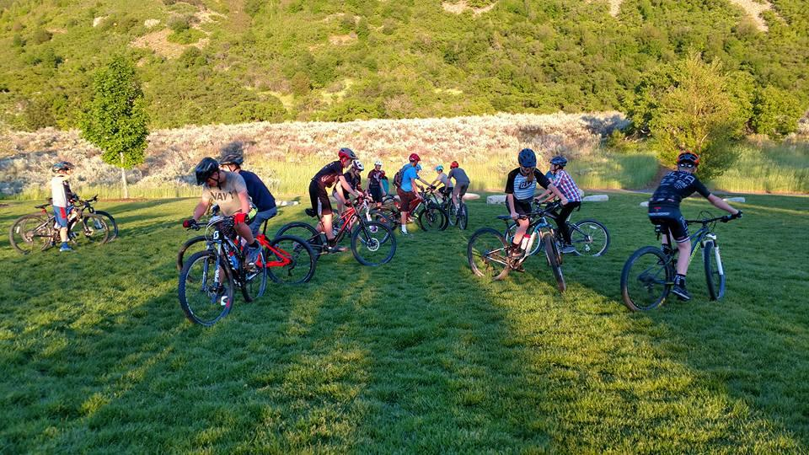
The Team
What Makes JD Great!
  We support each other
  Work hard/play hard
  Enthusiastic coaches/parents
  School support (not official school sport)
  Alta HS affiliation
  Team Captain
  Connor Doyle
Team Meeting

Slide 18
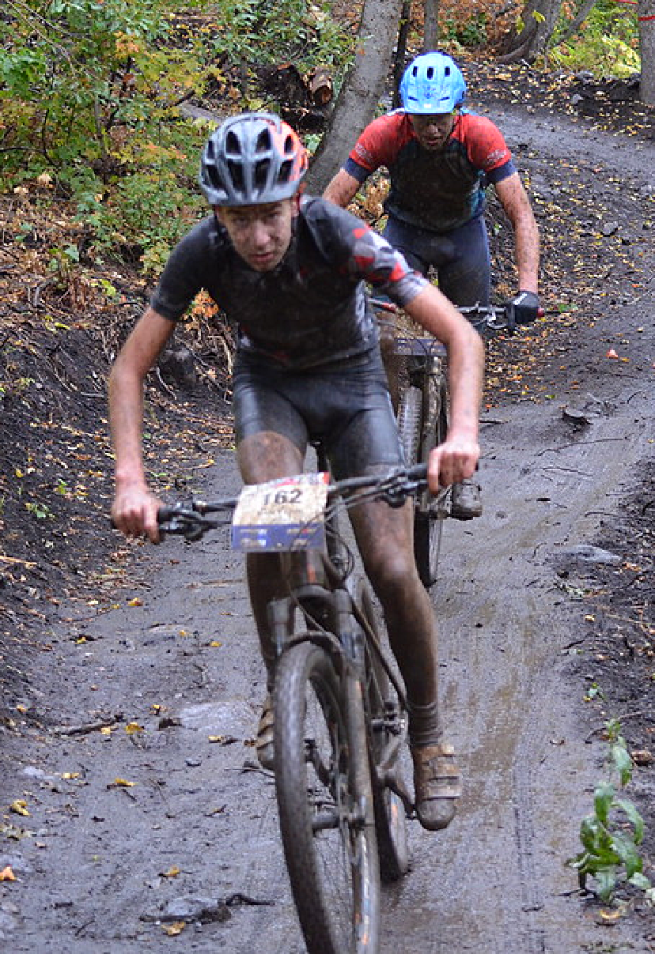
Team Goals - Why We Race
  To enable Juan Diego Catholic High School students to develop the lifelong sport of mountain biking while honoring the Utah High School Cycling League’s 5 core principles of strong body, strong mind, strong character, inclusive and equality.
  To enable students to develop personal discipline and a strong work ethic through training and racing.
  To develop a fun, safe atmosphere where students can develop friendships and JD pride.
  To teach mountain bike handling skills and fundamentals to reduce injury risk and enable students’ bike confidence.
Team Meeting

Slide 19
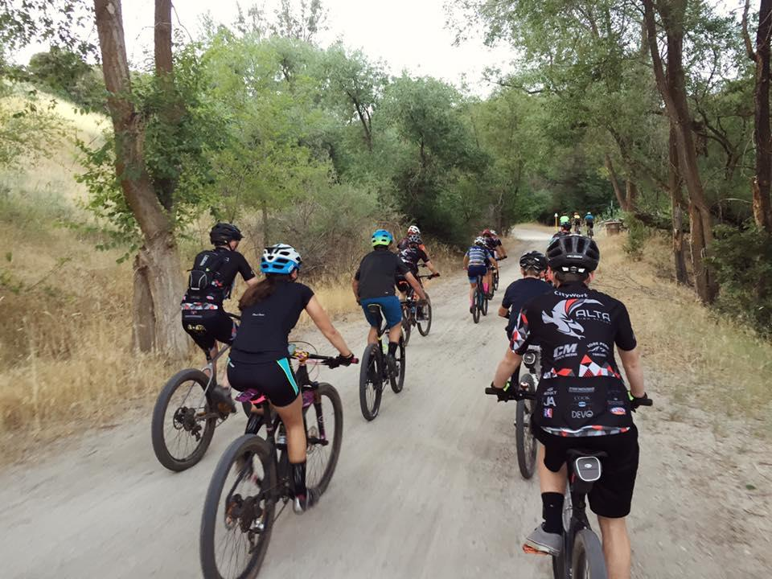
Practice Schedule
April-May – Preseason
  Maintenance and skills clinics, team activities, group rides
  New riders must pass off skills basics – attack position, braking, cornering, descend, ascend
  Advanced skills practice for experienced riders
June 1st – Regular Season starts
  Two rides per week in June, see Teamsnap Calendar
  Tuesday 6:00 – 8:00am
    Corner Canyon
    (until school starts, then evenings)
  Thursday, 6:30 – 8:30pm
    Snowbird, Solitude, Corner Canyon
    (start time changes as sunset gets earlier)
  Saturday 9:00am – 11:30am, Park City
    (meet at Alta for carpool, 8:00am)
Team Meeting

Slide 20
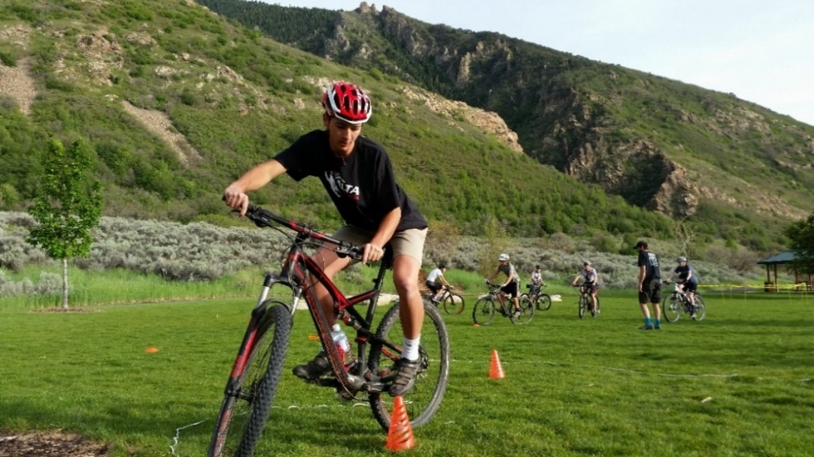
Practices
Expectations
  Arrive 15 minutes early – be ready to ride on time
  RSVP in Teamsnap
  If absent, discuss make up ride with Head Coach
  Follow ride leader instructions
  Be prepared - water, tube, food, proper clothing
  Typical Practices
  Start with announcements/reminders
  Skills practice in parking lot and flow trails
  Groups based on ability – 2 to 3 ride leaders each
  Rides will vary between endurance, intervals, technical and race skills
  Training Peaks high school plan
Team Meeting

Slide 21
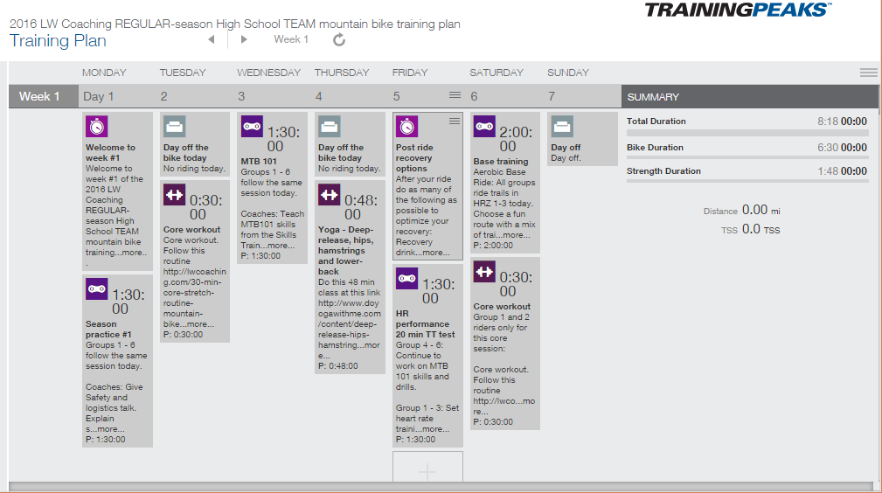
Training Peaks
Individual and Team plans
  Designed by Lynda Wallenfels, a USA Cycling certified mountain bike coach and NICA coach working with the St. George HS teams.
  Pre-season plans to prepare for season
  Email sent each day with workout
  Team plan for regular season
  Website application for tracking progress
Team Meeting

Slide 22
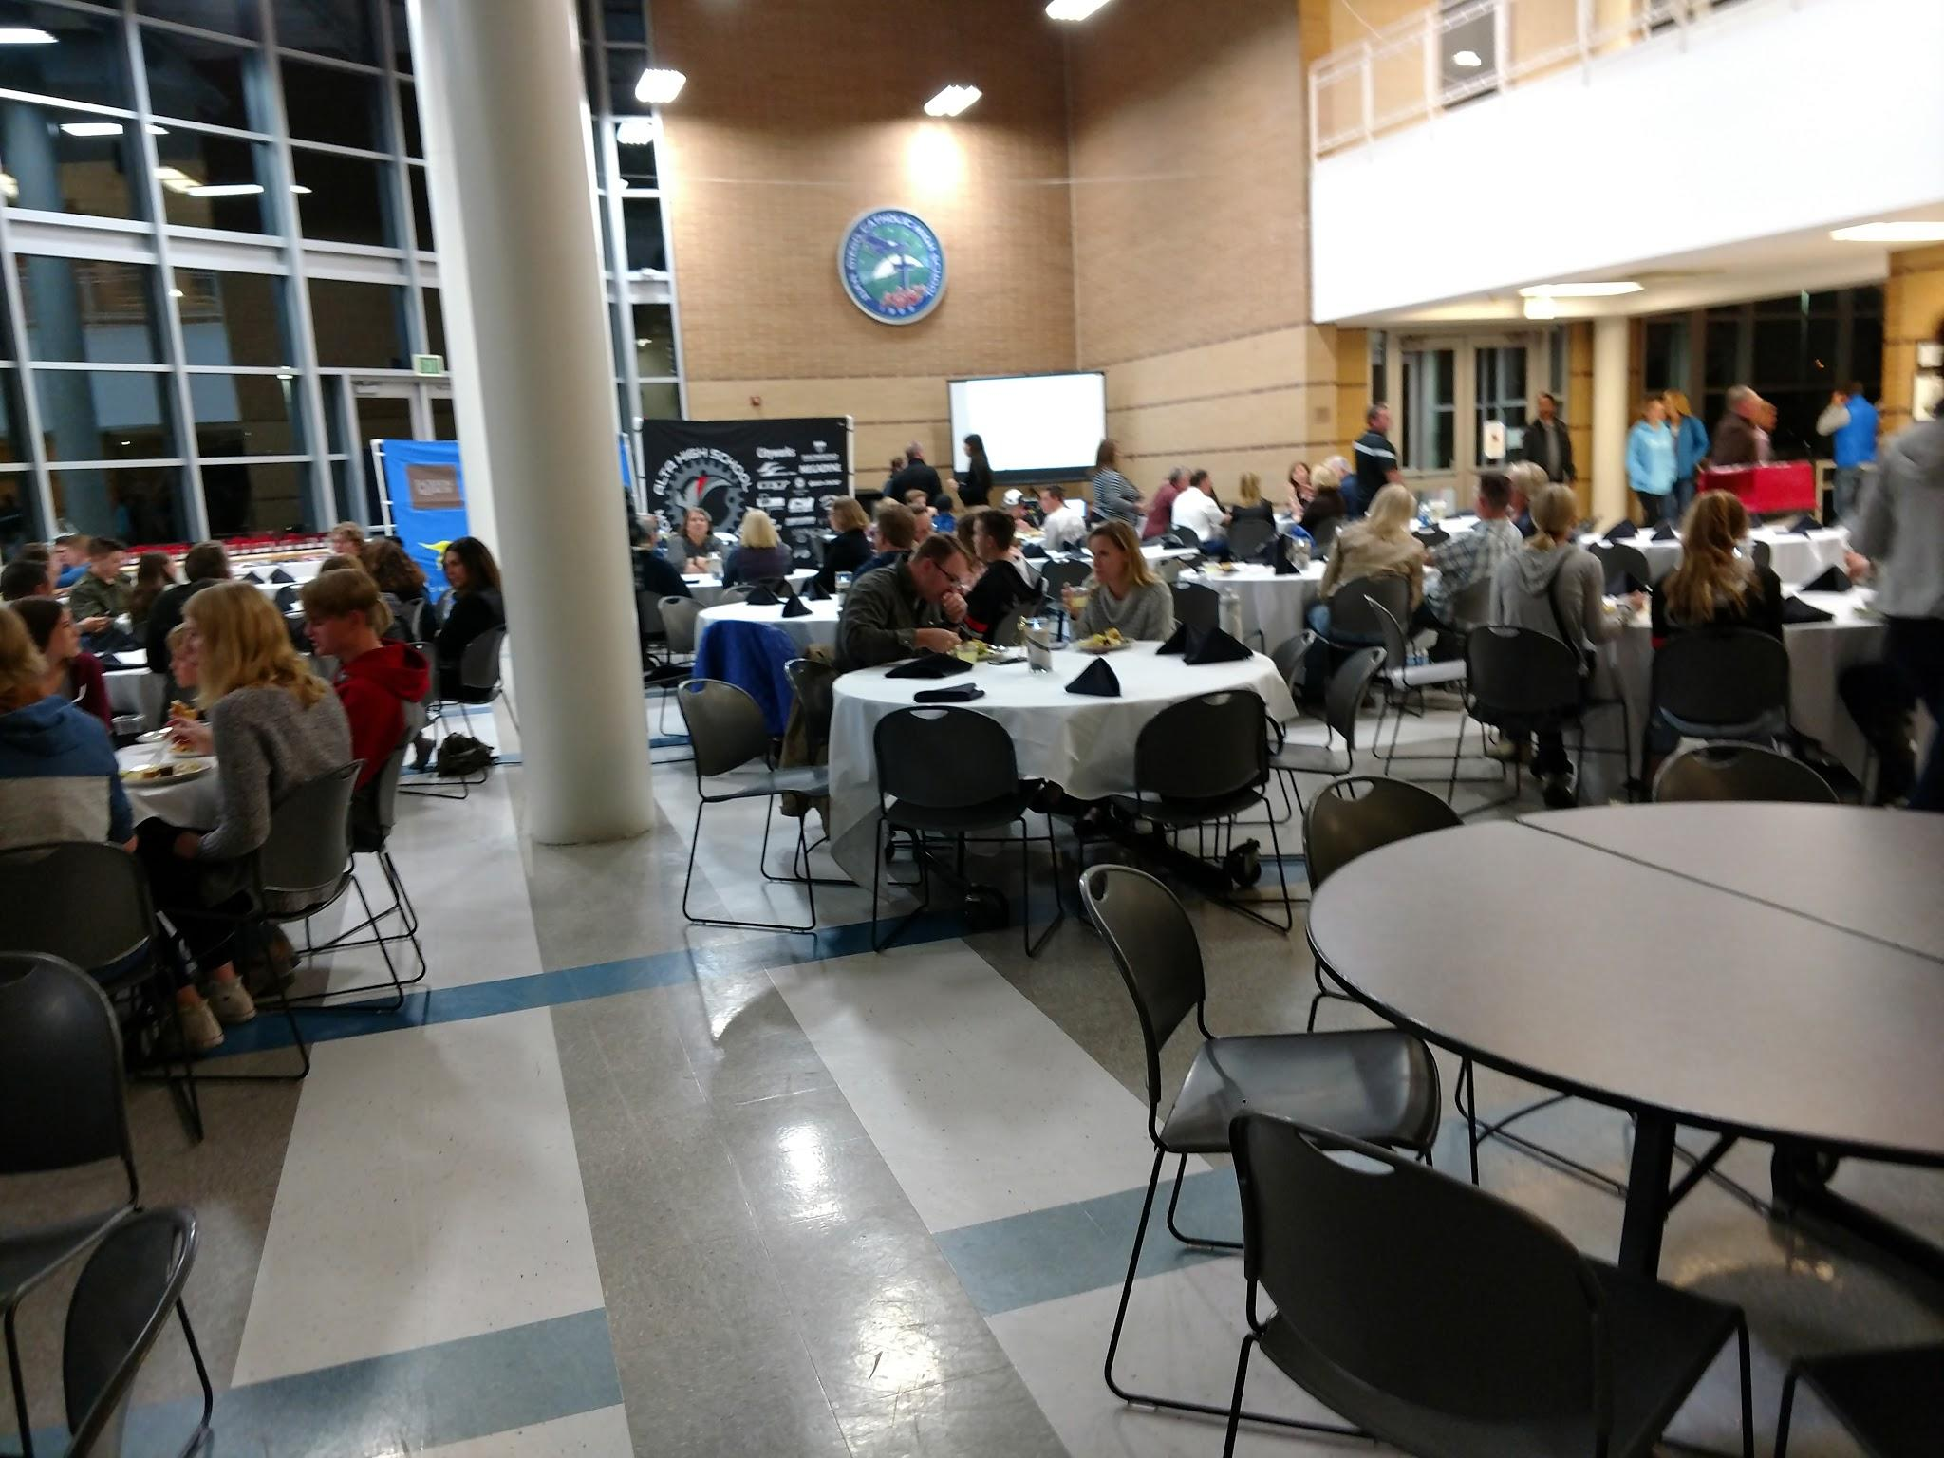
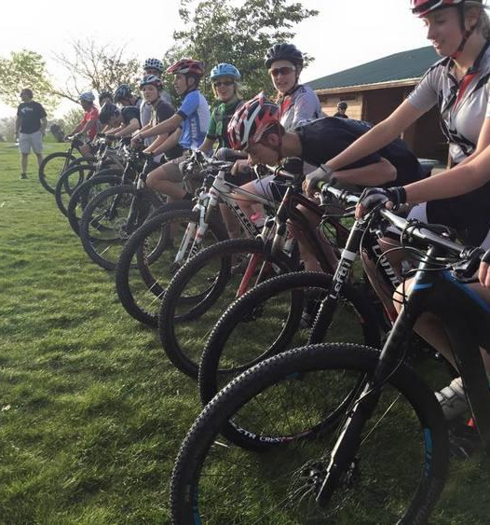
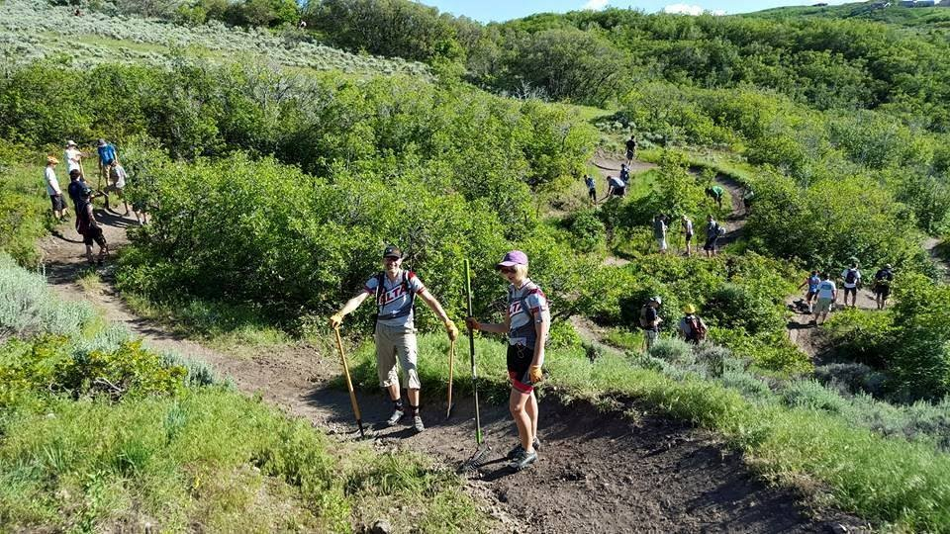
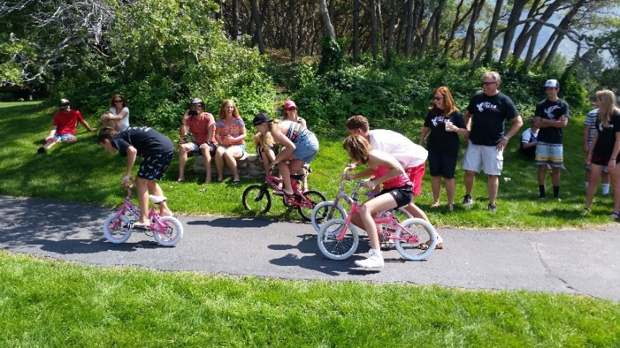
Other Activities
  Lizard Skins factory tour – May 3
  Maintenance clinic at Go-Ride – May 10
  Trail work days – TBD
  Taco Tuesday - TBD
  Movie night – TBD
  End of season dinner – Nov
Team Meeting

Slide 23
Communication
Website
  jdchsmtb.com
  Documents, videos, sponsors, calendar
Facebook
  https://www.facebook.com/groups/jdchsMTB/
  Share photos/other info
Instagram
  https://www.instagram.com/jdchsmtb/
  #jdchsmtb
Strava
  https://app.strava.com/clubs/altahsmtb
  Track rides, informal competition
Teamsnap
  Website and smartphone app
  Full schedule
  Contact information
RSVP
  Payment tracking
  Documents
Twitter
  https://twitter.com/jdchsmtb
Team Meeting
Notes:
Please RSVP on Teamsnap

Slide 24
Rules
  Sportsmanship – be supportive of team members and other races, no bullying or cliques
  Helmets – always on if standing over or riding a bike
  Safety – maintain safe speeds and stay within ability level
  Respect – stay on legal and open trails, pass with care
  Eligibility & Grades – maintain 2.5 gpa or higher
  Attendance & Participation – no unexcused absence after August 1st
  Service & Volunteering – service projects and family volunteers
  Practice Groups – stay in groups organized by skill/fitness level
  Bicycles & Maintenance – keep bike properly maintained
  Injuries – report to coach
  League Rules – no caffeine at races, alcohol, tobacco, vaping, illegal drugs
  Racing – commit to two races
All team members must sign rules form
Team Meeting

Slide 25
Insurance via league
Events:
$2,000,000 + additional $1,000,000 Each Occurrence
$4,000,000 + additional $2,000,000 Aggregate
Accident Medical:
  $25,000 Each Person - Excess Accident Medical
  $100 Deductible
Accidental Death: $10,000
Volunteer Coverage: Yes
Clubs/Teams:
General Liability
  $1,000,000 Each Occurrence
  $3,000,000 Aggregate
  $1,000,000 Each claim - Sexual Abuse and Molestation
    $500,000 Aggregate Limit
Accident Medical:
  $25,000 Each Person - Excess Accident Medical
  $250 Deductible
Accidental Death: $10,000
Volunteer Coverage: Yes
Coaches:
Same coverage as club (“coaches are covered while acting within the scope of their duties for their club/team”)
Team Meeting

Slide 26
Costs
  Team Fees
  $270 - includes jersey, shorts, socks, t-shirt, water bottle, pre and post season parties, sports drinks/food, race day meals)
    Pay by Wednesday, May 3th.
  League Fees
  $25 – NICA Membership fee
  $150 – Utah cycling league registration fee
    Must pay before participating in any team activities
  $100 race fee covers all 5 races
    Must be paid by July 20th
  League scholarships to cover race fees are available for all students in need
  Race fees covered for some race crew positions
  Payment plan available
Team Meeting

Slide 27
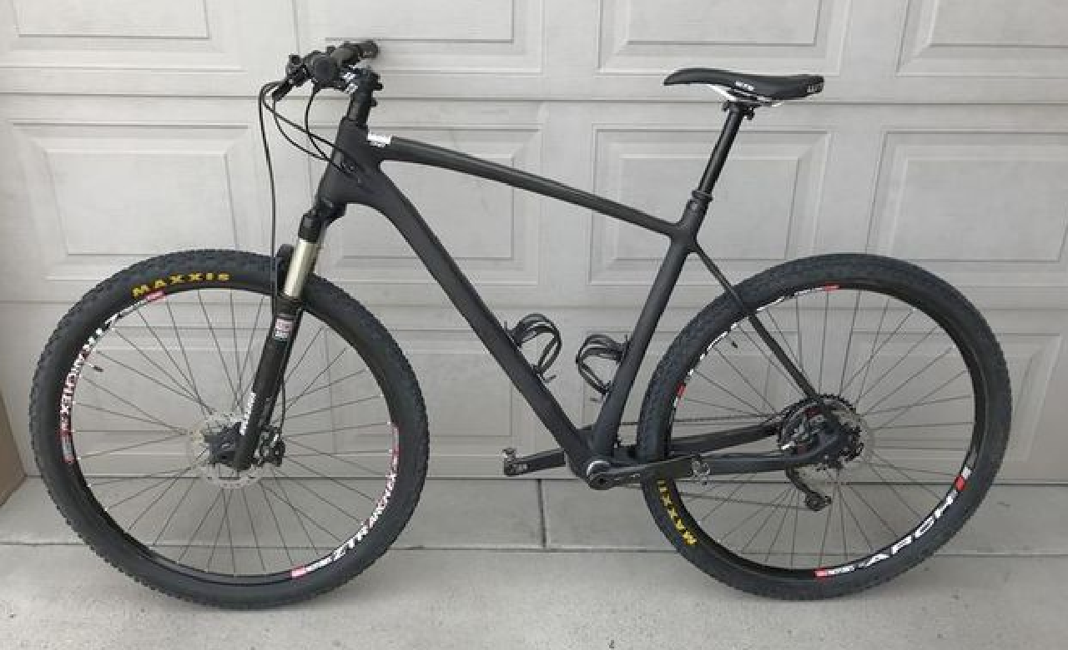
Equipment Costs
  $1000+ for mountain bike
    Hardtail or XC full-suspension
    29 or 27.5 inch wheels
  Loaner bikes available from team
    Requires 5 race commitment
    Borrower responsible for maintenance and repair
  Helmet, gloves, sunglasses, shoes for clipless pedals or shoes with good flat pedals, spare tube, c02 inflator
Team Meeting

Slide 28


Discounts
Bicycle discounts
  Work with Go-Ride for NICA discounts on Pivot, Santa Cruz, Yeti, and Giant bikes
  GT bike discounts through Steve Spencer
  Diamondback Bicycles through Utah league
Other Equipment
  Discount on Bell helmets
  Gloves and grips from Lizard Skins
  Free gloves from Alpinestars
Contact coach for more details and visit league website, www.utahmtb.org/benefits-main
Team Meeting

Slide 29
Team Expenses
Team Costs
  Team Registration Fee with the League
  Equipment needs – chairs, canopies, work stands, bike maintenance supplies (tubes, sealant, lube, etc.), food prep and service supplies
  Training plan, Teamsnap, web hosting
  Loaner bikes
  Transportation and fuel costs
  Coach/Ride Leader training and registration costs
  Prizes and awards
Any of these costs can be offset by sponsorship and fundraising by the team
Team Meeting

Slide 30
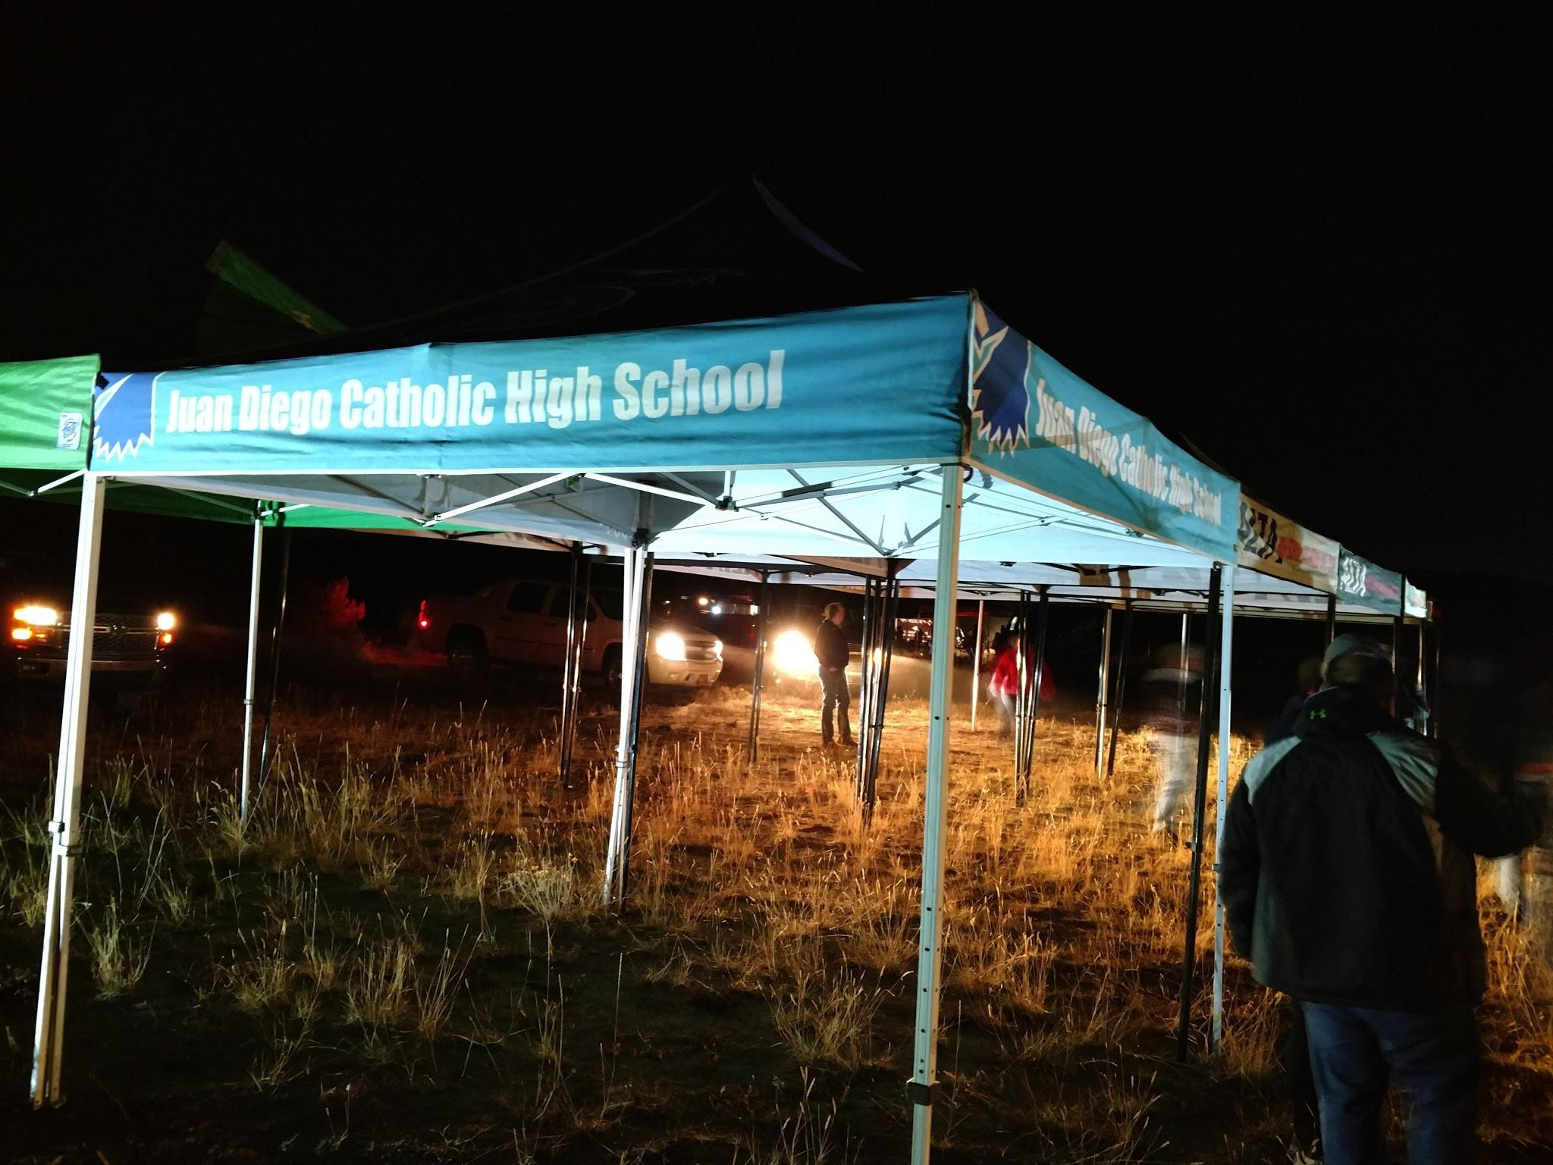
Sponsorship and Fundraising
Students – Bring in a sponsor for discount on club dues
  $250 level: 25% discount
  $500 level: 50% discount
  $750 level: 75% discount
  $1000+ level: Club dues waived
  Deadline is April 29th for jersey logo
  Information document on team website
Fundraising
  We need your help with ideas
  Our club fees are paid through the Skaggs Catholic Center and all donations are tax-deductible
Team Meeting
Notes:
I have a sponsorship document that details the program that you can give to potential businesses.

Slide 31
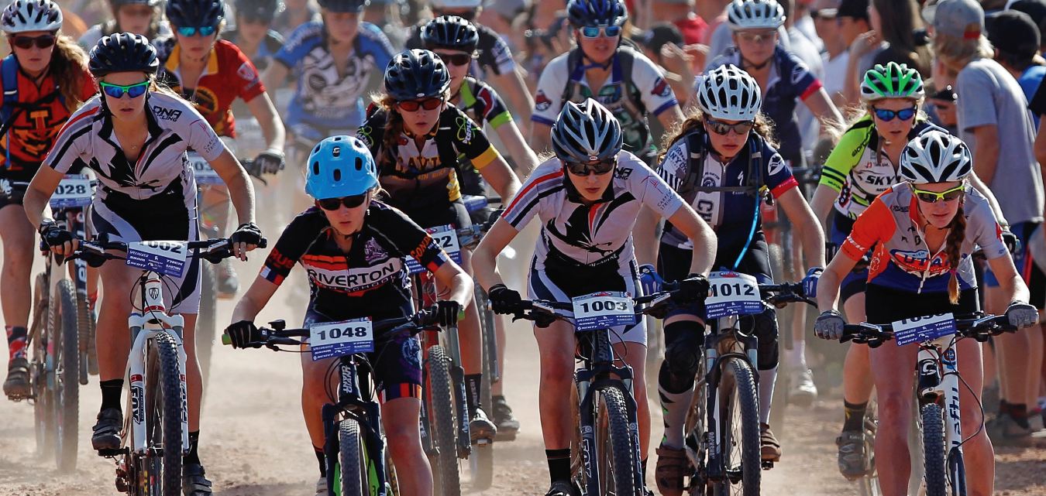
Race Schedule
Central Region
  Soldier Hollow, Midway – Aug 18
  Snowbasin – Sept 1
  Vernal – Sept 15
  High Star, Kamas – Sept 29
  St. George – Oct 19-20 (state championship)
Team Meeting

Slide 32
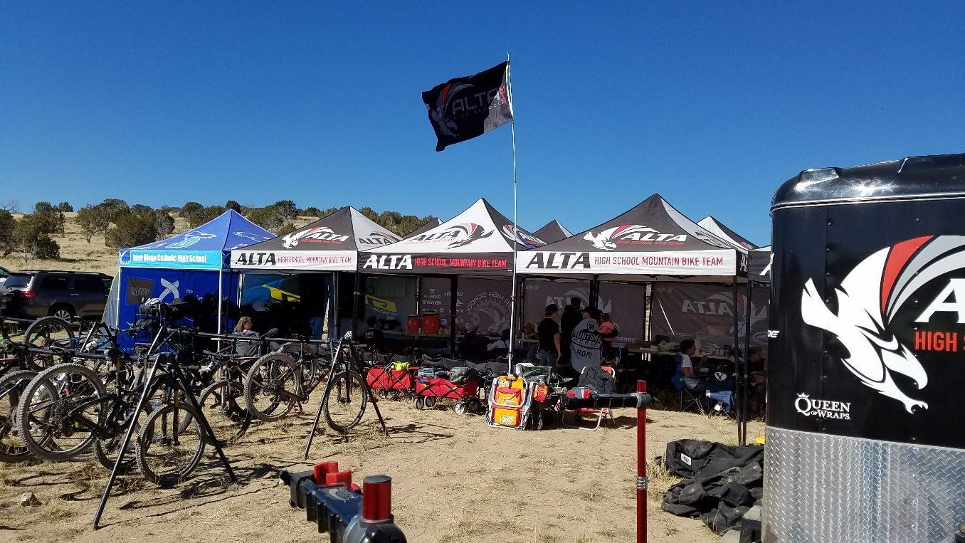
Race Day
Expectations
  All day event
  Cheer and encourage teammates
  Base camp setup/takedown
  Pre-ride course
  Podiums after racing completed
Food
  Light breakfast and lunch provided
  Water, sports drink, bar, gels
Team Meeting
Notes:
Please try and stay for entire day.

Slide 33
Uniform
Team Meeting

Slide 34
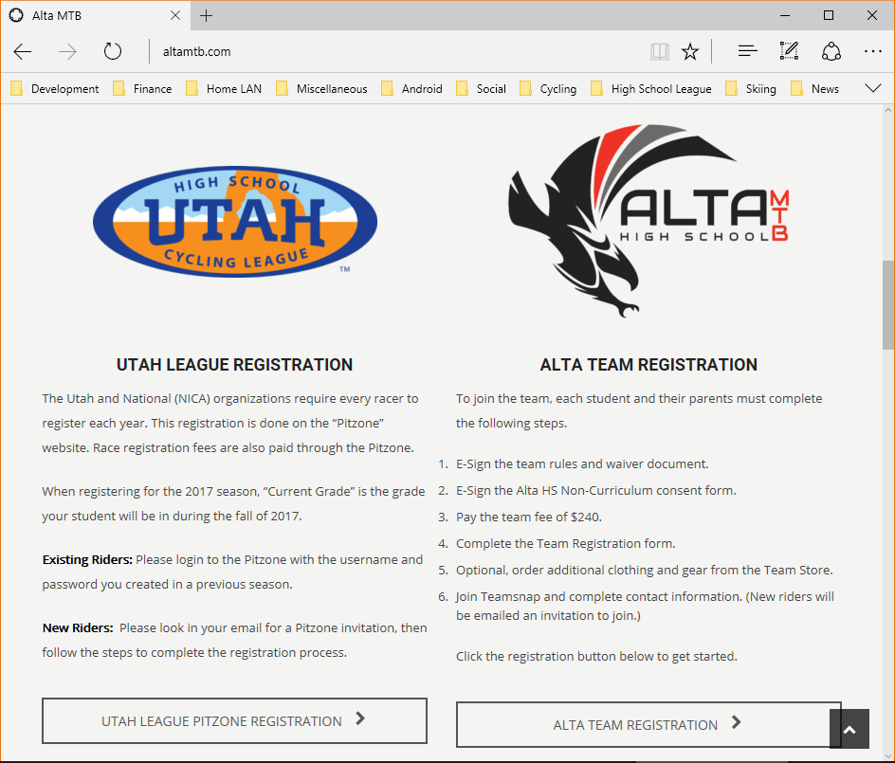
How to Register - Team
Complete Team Registration Process
  http://jdchsmtb.com
  E-Sign Team Waivers and Rules
  E-Sign Non-Curriculum Consent Form
  Pay team fees to Coach Robert
  Complete Registration Information form
  Purchase additional team clothing and gear
  Must be done by April 25th
Team Meeting

Slide 35
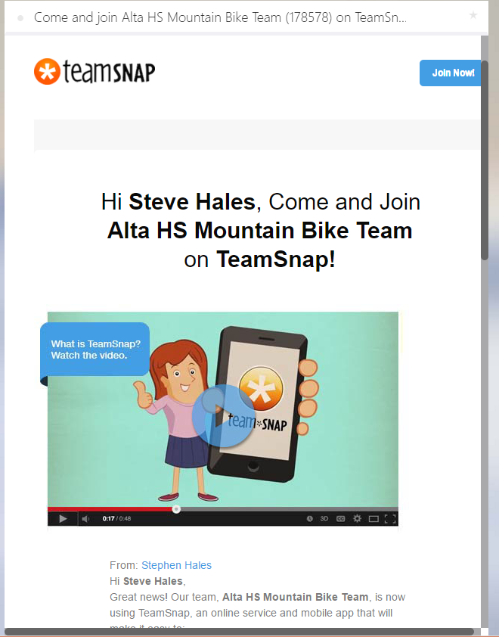
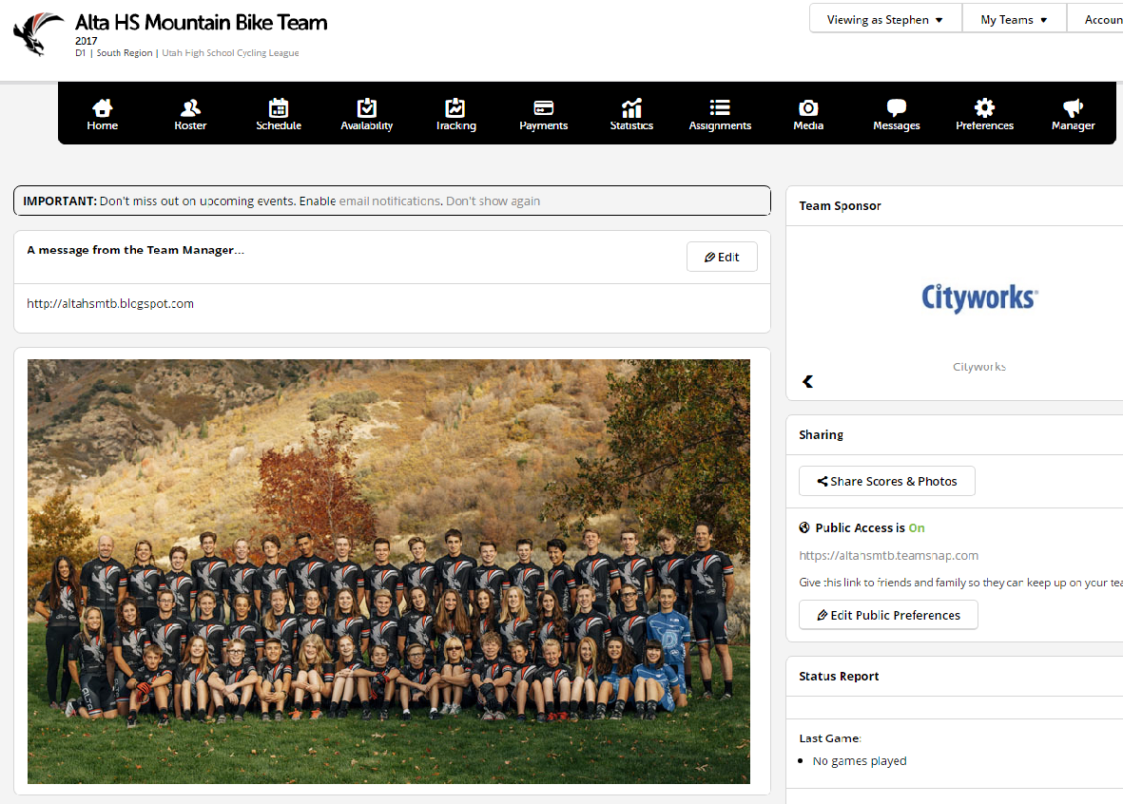
How to Register – Teamsnap
Register on Teamsnap
  Watch for email invite if new to team
  Complete/update all contact info
  Install mobile app
Team Meeting

Slide 36
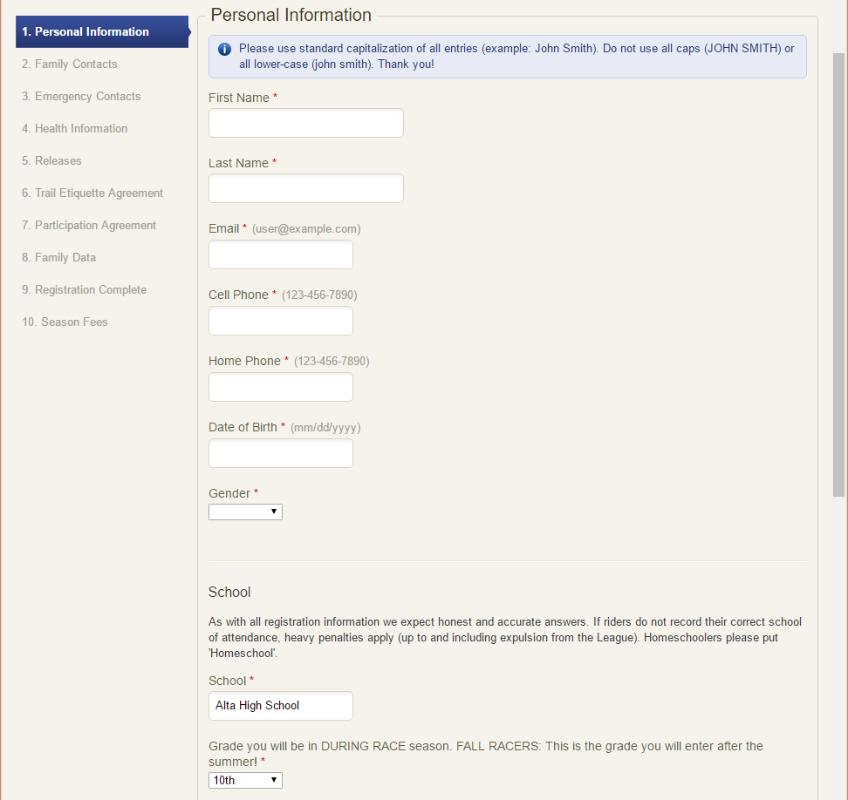
How to Register - Pitzone
Register in the Pitzone
  Watch for email invite if new to league
  Fill out personal information
  Complete contact and health forms
Team Meeting

Slide 37
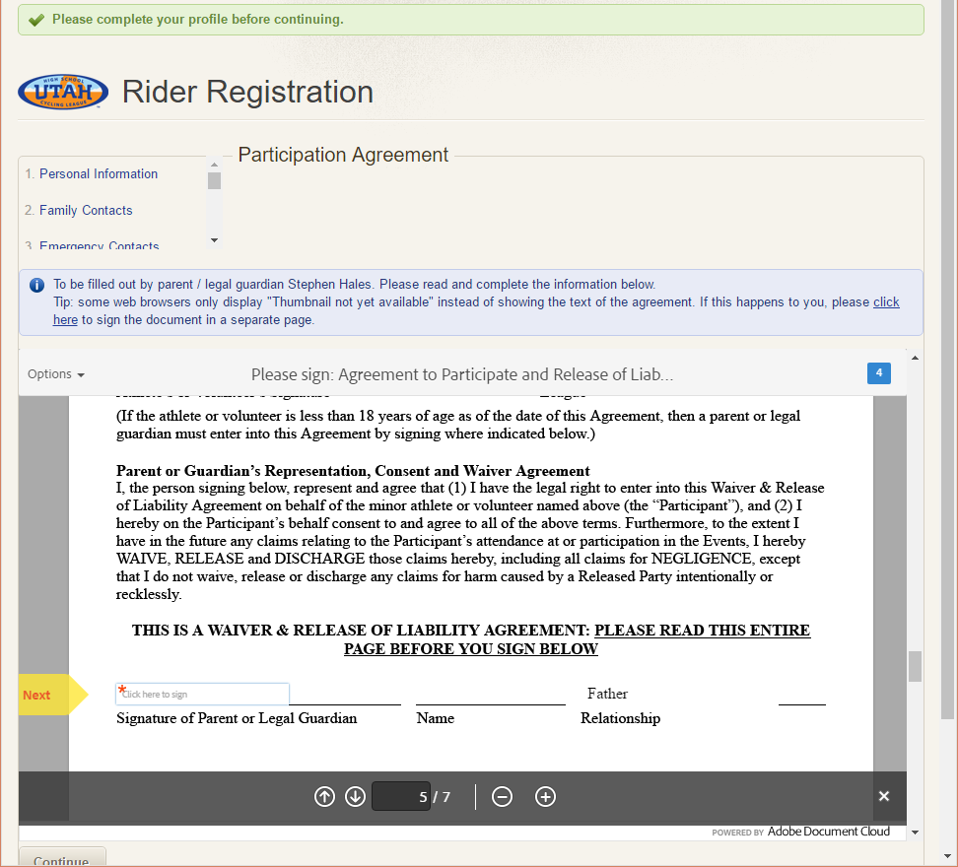
How to Register - Pitzone
Register in the Pitzone
  Electronically sign the Participation Agreement/Waiver
Team Meeting

Slide 38
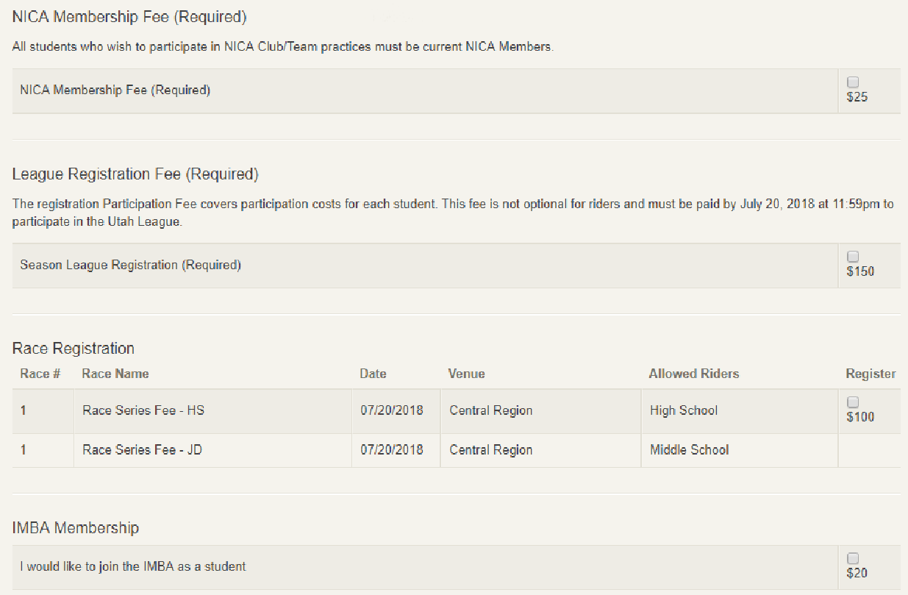
How to Register - Pitzone
Register in the Pitzone
  Pay Season Fees
  Must be done before participating
  in any team activities
Team Meeting

Slide 39
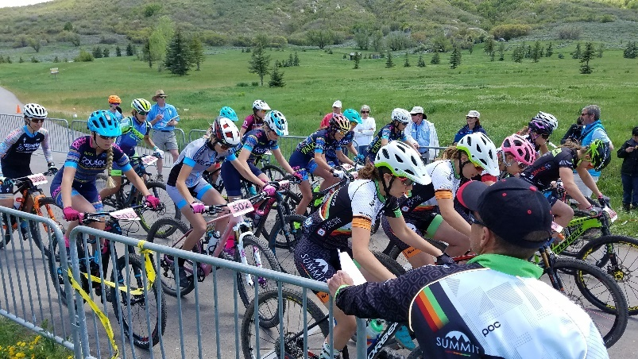
Other Events
  Bike Swap, 4/21, 9:00am – Noon at Hanger 15 shop in South Jordan
  Midweek MTB races, Tuesday evenings, various locations on Wasatch Front
    1st race on 5/1 in Heber Valley, lots of volunteers needed, free future race
    XC and Mini-Enduro
  Intermountain Cup race series, Saturdays, various locations in Utah
  Soldier Hollow ProXCT – May 5th
  Wasatch 360 – May 26th
Team Meeting

Slide 40
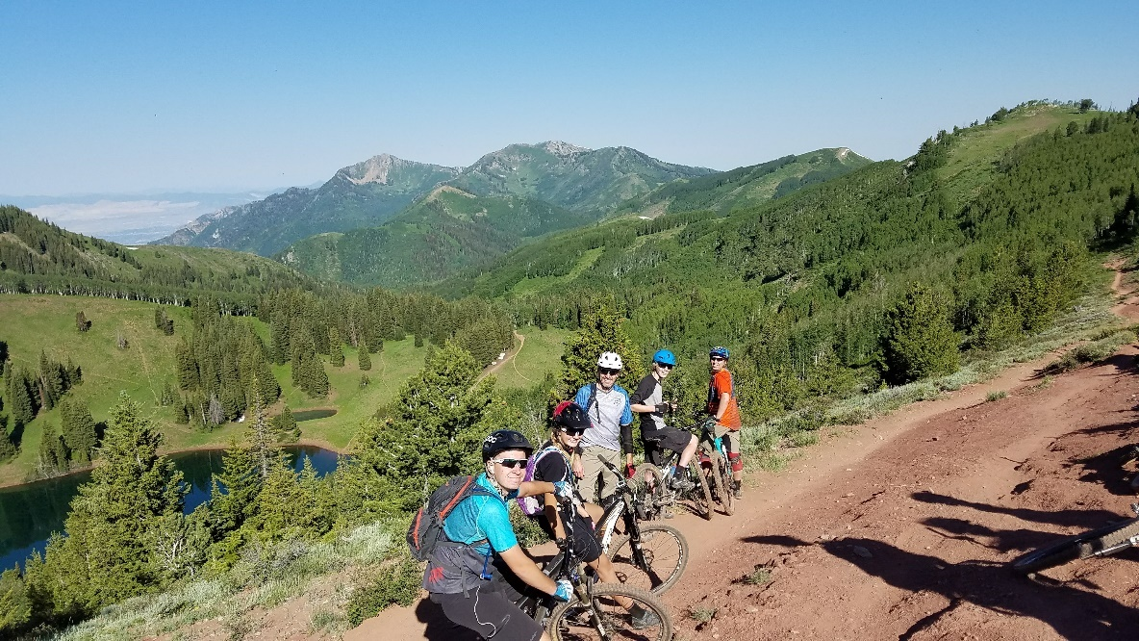
Reminder
Complete registration process at team website, http://jdchsmtb.com
Complete Teamsnap registration, https://altahsmtb.teamsnap.com
    Look for email invite if new to team
Complete Pitzone registration, https://pitzone.nationalmtb.org
    Look for email invite if new to league
Registration deadline, April 25th
Sponsorship deadline, April 29th
Go outside and ride your bike!
Team Meeting

Slide 41
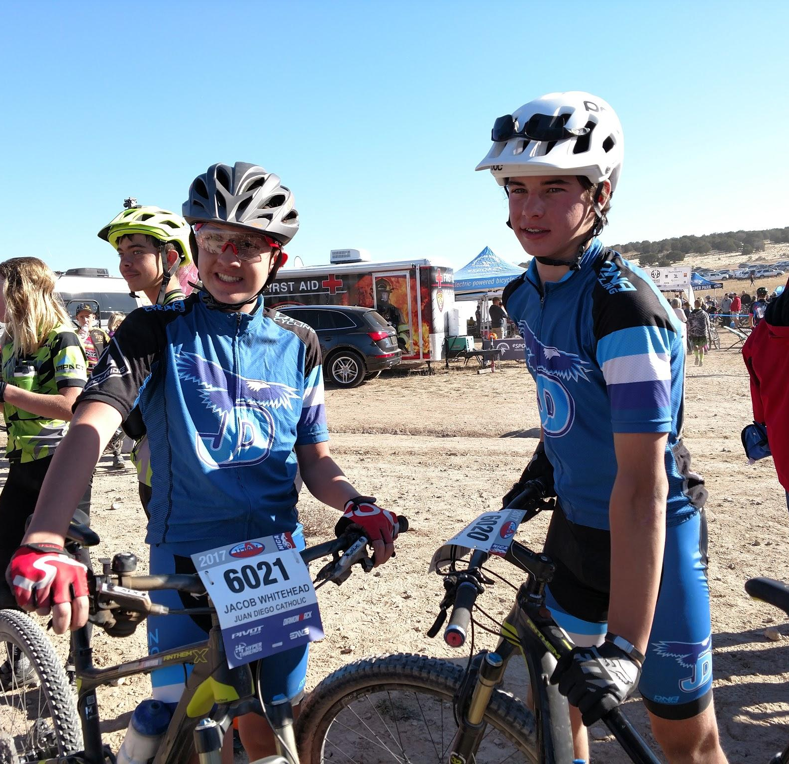
Fit Kit
  Sizes of jerseys, bib shorts and regular shorts are mens except for womens shorts
  If you choose a women’s short, order one size larger than fit kit
  Race kit should fit snug, not loose
Team Meeting

Slide 42
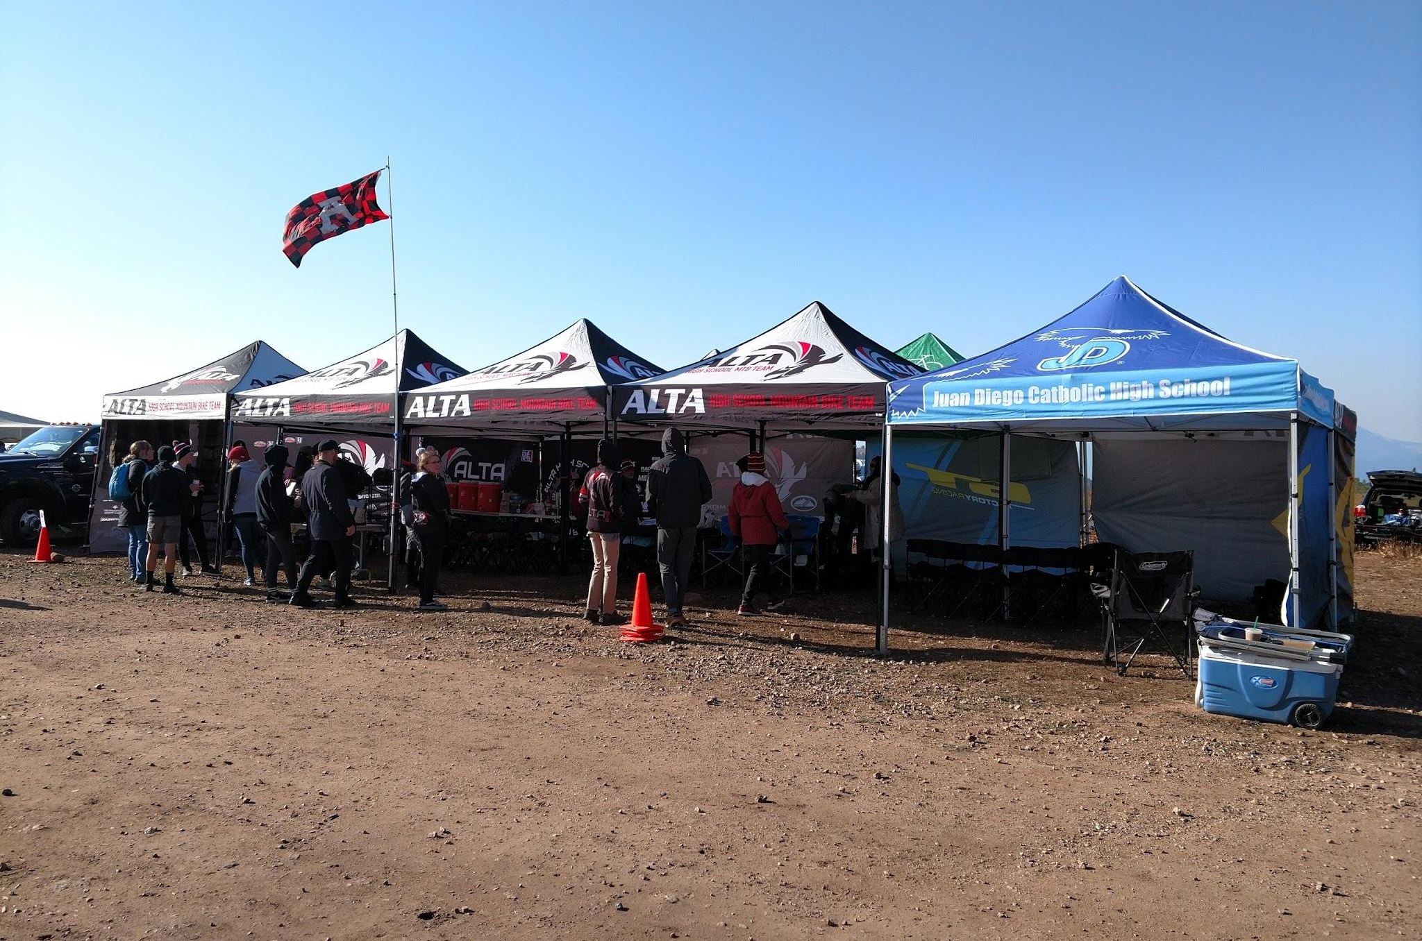
Volunteers
League Volunteers
  Each family required to volunteer at least once
  Race sweep
  Scoring
  Parking
  Trail marshal
  Setup/takedown
  Usually a half day shift
Team Help
  Ride leaders
  Food Prep
  Party planning
  Base camp setup/takedown
  Sponsorship/fundraising
  Team administration
  Transportation
Team Meeting

Slide 43
Contact Info
Team Director
Mike Doyle
801-573-2563
medoylejr@gmail.com
Head Coach
Robert Steele
801-910-8884
jdchsmtb@gmail.com
Central Region Director
Brooke Howard
385-227-5741
brooke@utahmtb.org
Team Meeting

